Slide 1
AWS LANDING ZONE DEPLOYMENT USING TERRAFORM
BY- KAVYA S
ASSOCIATE CLOUD ENGINEER INTERN

Slide 2
25 MINUTES CONTENTS
OBJECTIVE
INTRODUCTION
AWS CONTROL TOWER
ROLES AND POLICIES
ACCOUNT FACTORY FOR TERRAFORM(AFT)
CHALLENGES FACED
CONCLUSION

Slide 3
OBJECTIVE
Deploy a standardized landing zone infrastructure using terraform,incorporating best practices for security,network and account management.
This includes Terraform configuration files, network diagrams, IAM Policies, and deployment logs. In order to implement policies, the organizational structure entails the construction of Organizational Units (OUs) such as Log, Security, Prod, and Non-Prod, in addition to Service Control Policies.
Best practices for network security should be incorporated into the design of the VPC architecture, and consistency is guaranteed by automatic account provisioning via AWS Control Tower's Account Factory.
Important elements include AWS CloudTrail logging configurations, IAM role and permission management, secret management techniques, and compliance monitoring.
The project necessitates a careful methodology that makes use of both AWS Control Tower and Terraform to establish a secure and standardized AWS environment.

Slide 4
INTRODUCTION
A Landing Zone is crucial for organizations seeking to establish a robust foundation in the cloud. It serves as the architectural blueprint for deploying workloads securely and efficiently within cloud environments.
By implementing a Landing Zone, organizations can ensure consistent application of security and compliance standards across all accounts and workloads.
This includes implementing necessary security controls, managing access and identities, and enforcing compliance requirements. Additionally, a Landing Zone offers scalability and flexibility, allowing organizations to adapt to evolving business needs and accommodate growth seamlessly. Through automation and streamlined operational processes, it enhances efficiency while reducing the risk of errors.
Cost optimization is also facilitated by implementing best practices within the Landing Zone, enabling organizations to monitor and control cloud spending effectively.
Furthermore, centralized governance and control mechanisms provided by the Landing Zone ensure alignment with organizational objectives and minimize the risk of misconfigurations or unauthorized actions. Overall, a Landing Zone serves as the cornerstone for a well-structured, governed, and efficient cloud environment.

Slide 5
AWS CONTROL TOWER
AWS Control Tower serves as a pivotal component in the deployment of a standardized AWS landing zone infrastructure, aligning with best practices for security, networking, and account management.
With its centralized governance capabilities, Control Tower provides a unified platform for managing multiple AWS accounts, ensuring consistency and compliance across the organization. By automating account provisioning processes, Control Tower streamlines the creation of standardized account structures, complete with pre-configured security and compliance guardrails.
Its robust security features, including multi-factor authentication enforcement, AWS CloudTrail logging, and AWS Config compliance checks, bolster the overall security posture of the environment. Control Tower's organizational structure capabilities allow for the logical grouping of AWS accounts, facilitating efficient resource management and administration.
Furthermore, the enforcement of tagging policies and service control policies (SCPs) ensures adherence to tagging standards and fine-grained access control, respectively. Integrated auditing and compliance mechanisms enable continuous monitoring and remediation of compliance deviations.
Leveraging Control Tower alongside Terraform provides a powerful combination, enabling organizations to establish a solid foundation for their AWS environments while retaining flexibility for customization and scalability.

Slide 6
ROLES AND POLICIES
AWSControlTowerAdmin
- AWSControlTowerAdminPolicy (Customer managed)
- AWSControlTowerServiceRolePolicy
AWSControlTowerCloudTrailRolePolicy
- AWSControlTowerCloudTrailRolePolicy(Customer managed)
AWSControlTowerConfigAggregatorRoleForOrganizations
- AWSConfigRoleForOrganizations
AWSControlTowerStackSetRole
- AdministratorAccess
- AWSControlTowerStackSetRolePolicy

Slide 7
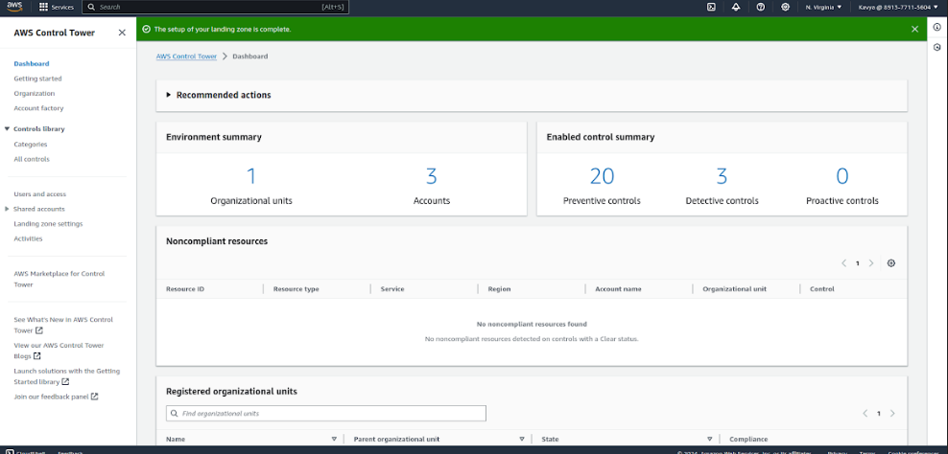
LANDING ZONE SET UP

Slide 8
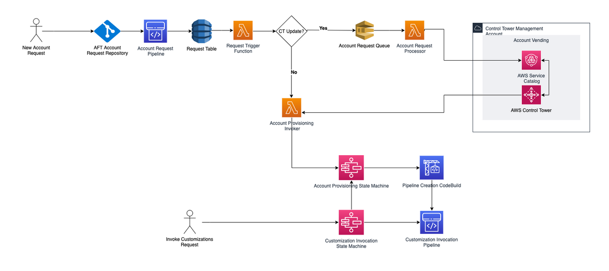
ACCOUNT FACTORY FOR TERRAFORM

Slide 9
CONCLUSION
In conclusion, the deployment of a standardized AWS landing zone infrastructure using AWS Control Tower and Terraform represents a comprehensive approach to achieving robust security, efficient account management, and adherence to best practices.
By leveraging AWS Control Tower's centralized governance capabilities, organizations can establish a unified platform for managing multiple AWS accounts, enforcing security guardrails, and ensuring compliance across the board.
Integrating Terraform allows for further customization and scalability, empowering organizations to tailor their infrastructure to specific requirements while maintaining consistency and efficiency.
Overall, this project enables organizations to lay a solid foundation for their AWS environments, fostering a secure, well-managed, and compliant cloud infrastructure ready to support business operations and growth.

Slide 10
THANK YOU

